Slide 1


Slide 2
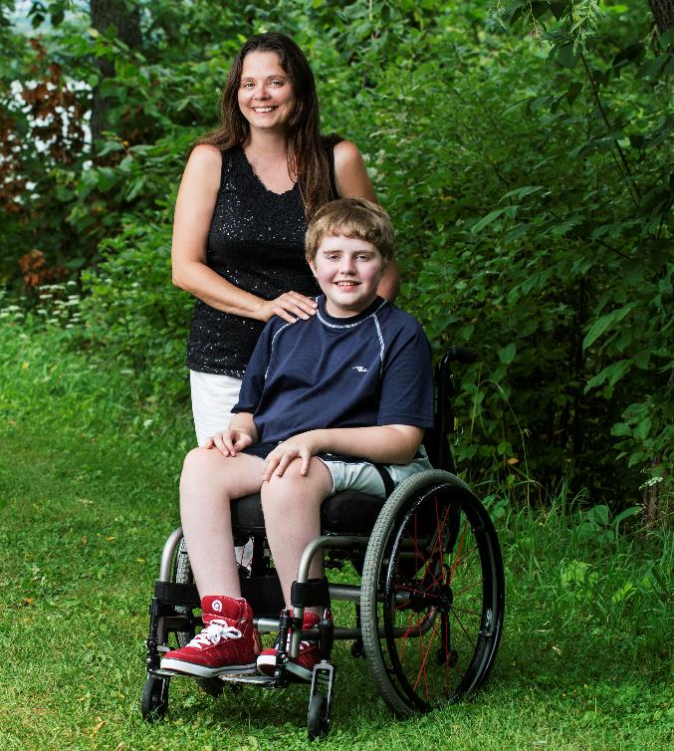
Over 90,000 New Brunswickers live with a mobility disability
Many individuals face barriers to community participation and employment
Poverty, inactivity and social isolation are common
This number will increase drastically as our population ages

Slide 3
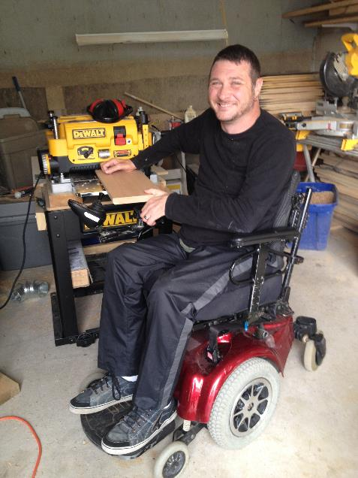
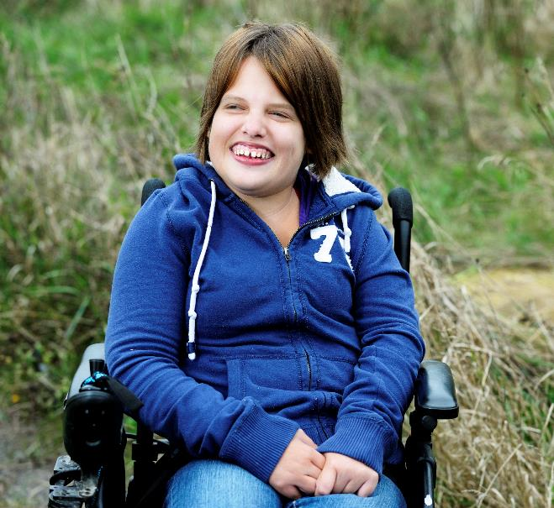
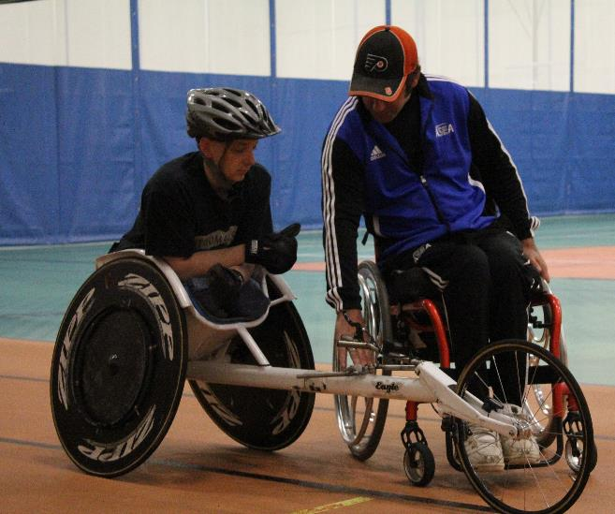
Our mission
To empower the independence and full community participation of persons who have a spinal cord injury or mobility disability by providing innovative services and developing progressive public policy.

Slide 4
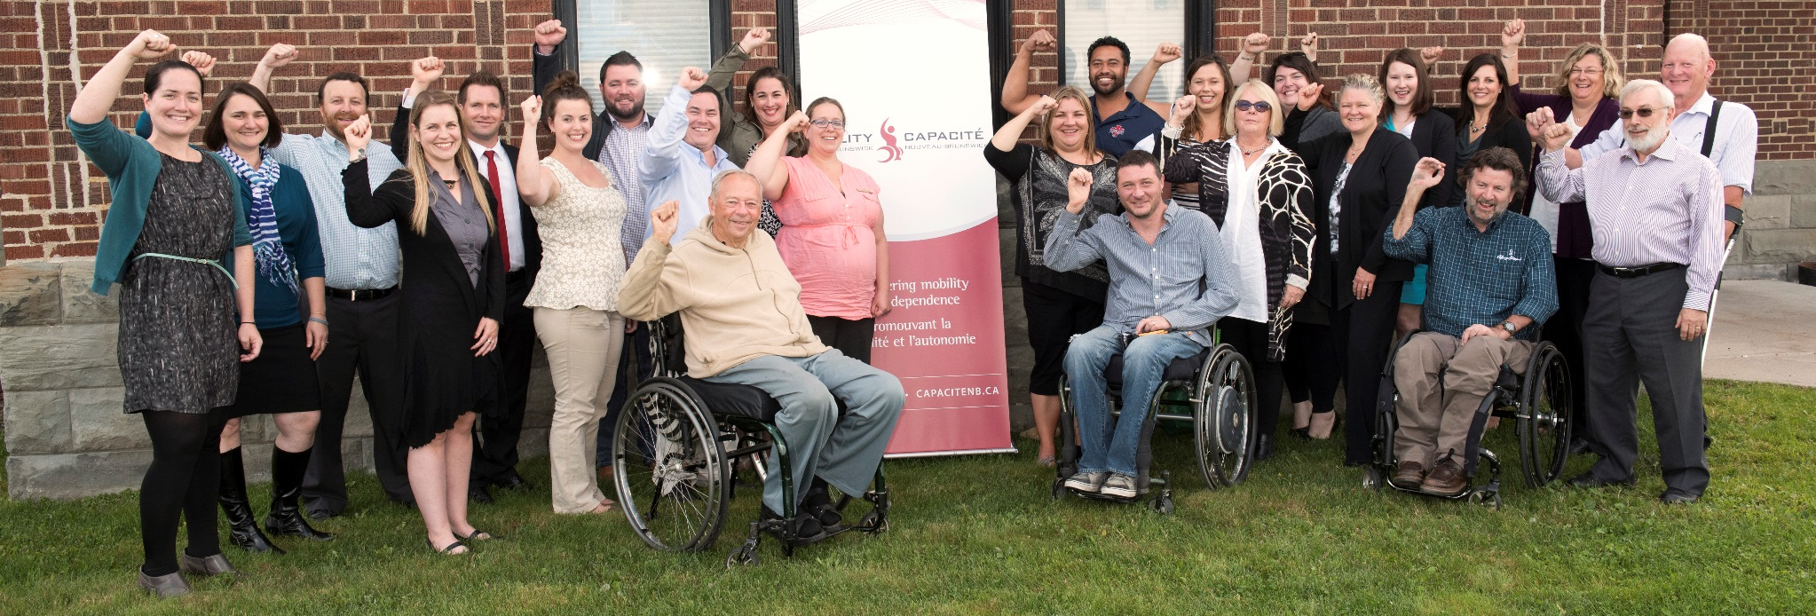
Things you may not know about Ability NB
We are a non-profit provincial agency governed by a passionate volunteer board of directors
Offices in Fredericton, Moncton, & Woodstock

Slide 5
Rehabilitation counsellors travel throughout the province to work with participants through an outreach approach
In 2014-2105, we worked one on one with 369 individuals and their families
We are “Goal Getters”, facilitating the attainment of 1450 personal goals!
Ability NB houses the Para-NB ELS

Slide 6
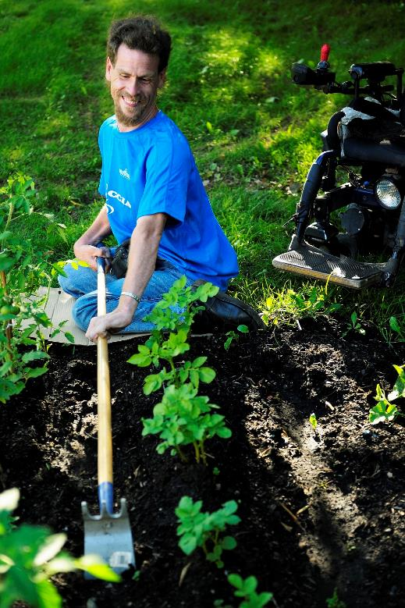
Ability NB services
Rehabilitation counselling
Case management & service coordination
Vocational & employment
Peer support
Community development & advocacy
Sport, recreation & active living
Information services & accessibility reviews

Slide 7
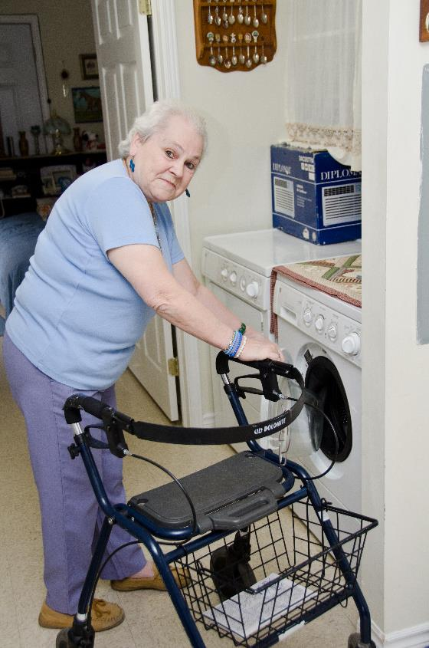
Ability NB works to empower…
Ability
Rehabilitation counsellors work with participants achieve as much independence as possible
Develop plans to reach personal goals
Find creative solutions and community partners to accomplish goals

Slide 8
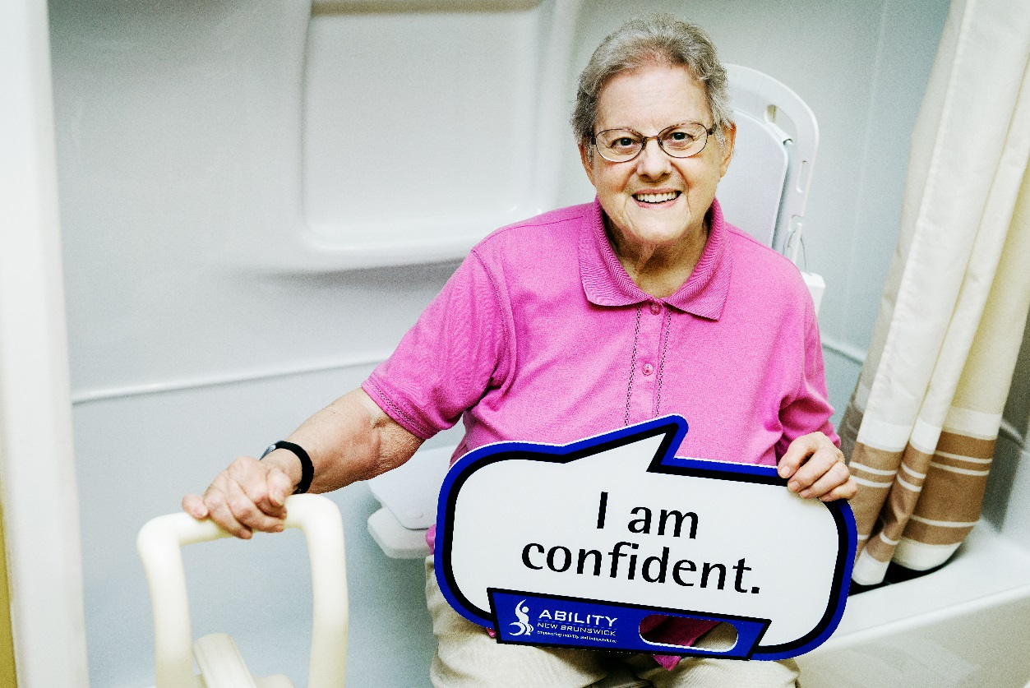
Solutions
The “Solutions Fund” provides financial assistance when all other avenues have been exhausted
  Technology and assistive devices
  Travel costs
  Items that are not covered by insurance policies

Slide 9
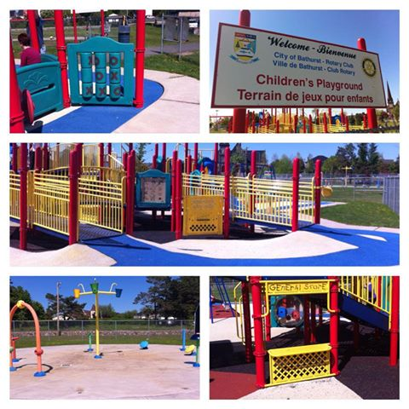
Inclusive Communities
Voice of people living with a mobility disability
Empower communities to identify, reduce and eliminate barriers
Work with community leaders to develop progressive public policy

Slide 10
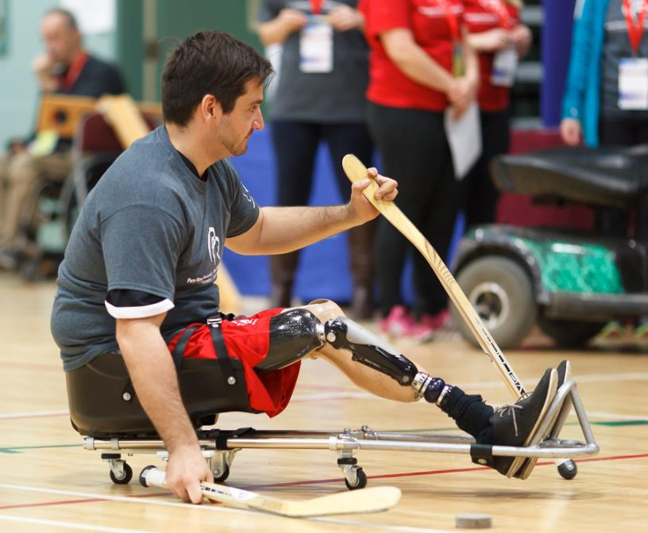
Active Living
identify active living interests and develop a plan for participation
link to sport and recreation programs
secure resources, equipment and devices needed for participation
host Para-NB and the Equipment Loan Service

Slide 11
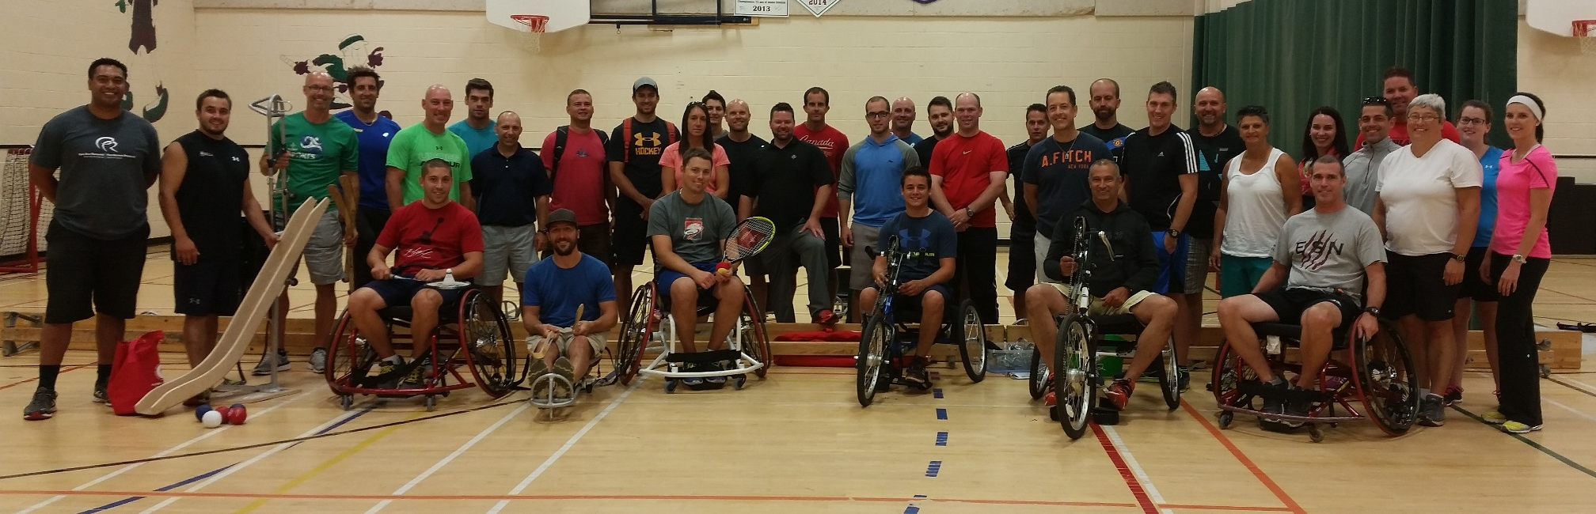
Demand for our services is growing!
  Number of participants has tripled
  50% of people over the age of 65 will incur a mobility disability
  Advances in medicine and technology
  Low employment rates
  Our provincial funding has remained unchanged for the last 10 years!

Slide 12
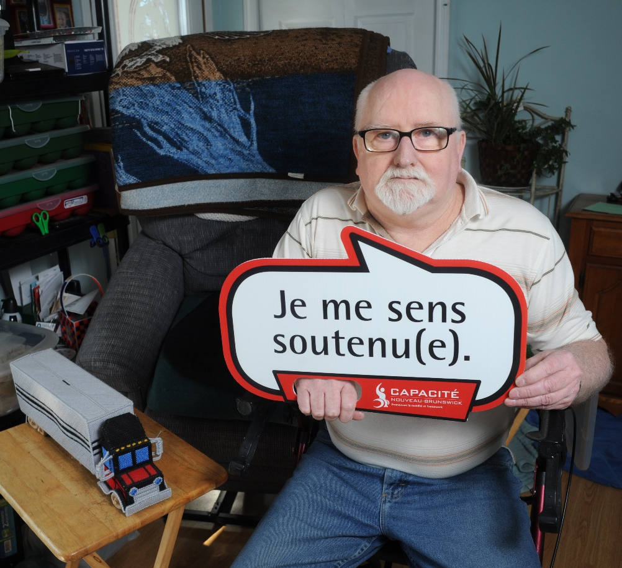
How can the Rotary Club help?
Commit up to $10,000 to allow Ability NB to provide:
    100 hours of rehabilitation counselling services
    equipment, supports, and other needed items through our “Solutions Fund”
In Bathurst and surrounding areas to people of all ages living with a mobility disability and their families.

Slide 13


Contact us
Fredericton Main Office Moncton Regional Office
440 Wilsey Rd, suite 102 236, rue St. George, bureau 407
Fredericton, N.B. E3B 7G5 Moncton, N.-B. E1C 1W1
Tel. : 506-462-9555 Tél. : 506-858-0311
or 1-866-462-9555
christina.collins@abilitynb.ca info@abilitynb.ca

